Slide 1
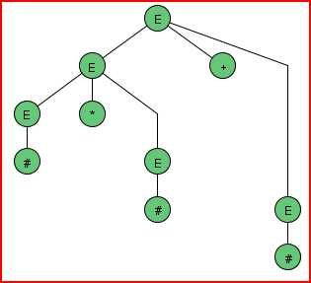
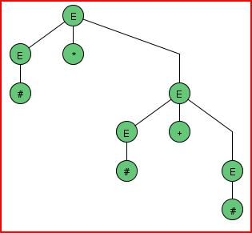
Derivation Trees
Does ambiguity matter? No if we are using a grammar to describe a language, but possibly yes if we are using a grammar to process a language. Here are two leftmost derivation trees for the expression grammar:
E → E + E
E → E - E
E → E * E
E → E / E
E → ( E )
E → #

Slide 2
Unambiguous Grammars
Sometimes an ambiguous grammar can be replaced with an unambiguous one:
E → E + E
E → E - E
E → E * E
E → E / E
E → ( E )
E → #
E → E + T
E → E – T
E → T
T → T * F
T → T / F
T → F
F → ( E )
F → #

Slide 3
More PL Examples
Grammar for a method call C, where m is a method name and E is an expression:
C → m ( )
C → m ( A )
A → E, A
A → E
Grammar for a while loop While, where Statement is a statement and E is an expression:
While → while ( E ) Body
Body → { Statements }
Body → Statement
Body → ;
Statements → Statement Statements
Statements → ε

Slide 4
Challenge Examples
Strings B containing equal numbers of a’s and b’s:
B → a B b B
B → b B a B
B → ε
Strings U containing more a’s than b’s:
U → B a T
T → B a T
T → ε
Does this work?
U → B U
U → a B
U → U U

Slide 5
Prove: Every Regular Language is a CFG Language
If R is a regular expression, let R’ be the grammar non-terminal that yields the language of R
R = ε
R’ → ε
R = a
R’ → a
R = R’₁ R’₂
R’ → R’₁ R’₂
R = R₁ + R₂
R’ → R’₁
R’ → R’₂
R = R’₁*
R’ → R’₁ R’
R’ → ε

Slide 6
Pushdown Automaton
Like a finite automaton, but:
There is a single stack
The decision to follow a transition can be governed both by the next input symbol and by the top of the stack
When following a transition, a symbol can be pushed
Your book uses a flowchart syntax for describing pushdown automata, but fortunately it is easily converted into the JFLAP description, which we’ll use.

